Slide 1
Project 2 :
COVID- 19 Dashboard
Group 3 :
Sneha
Jalil
Monica
Erika
Clinton
Radhakishore

Slide 2
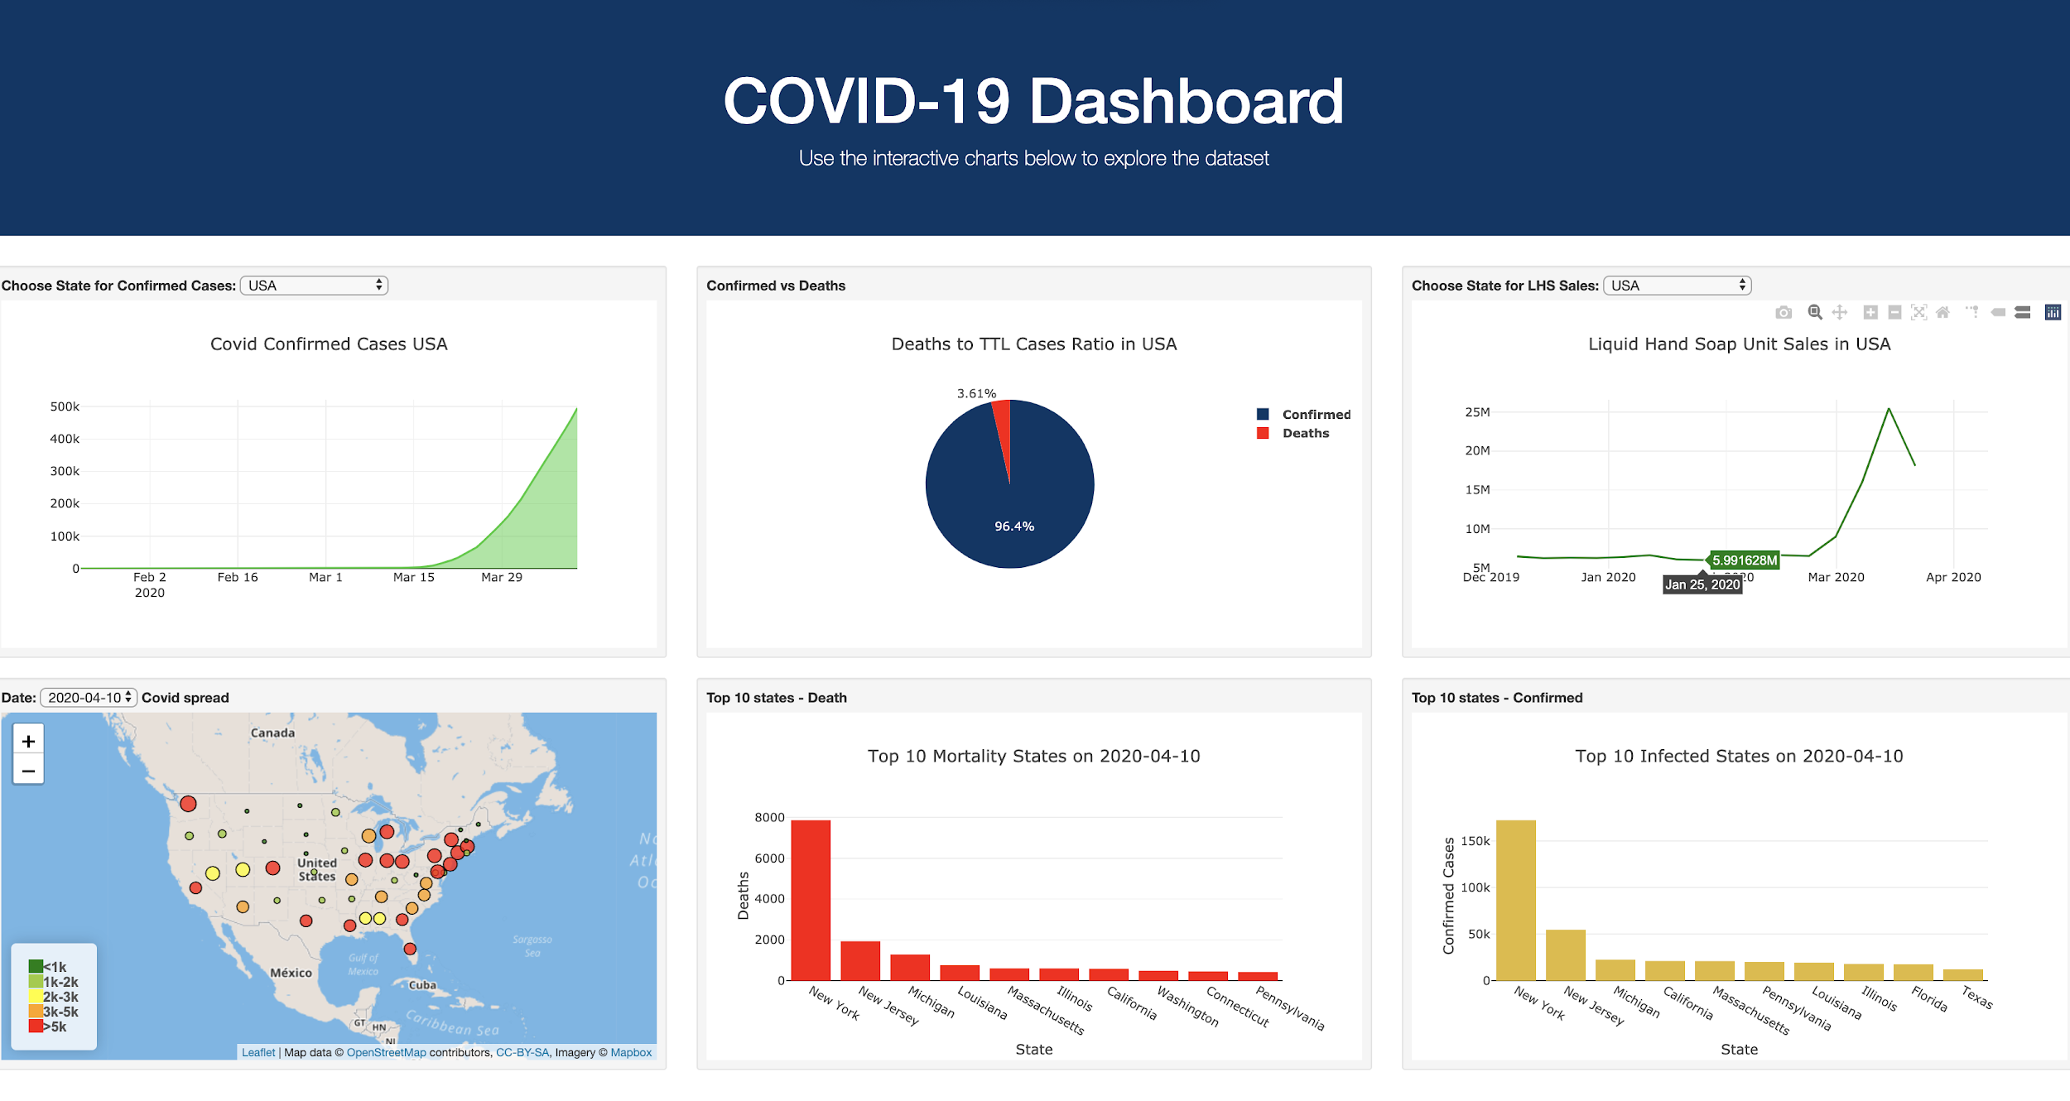
Purpose:
Show the progression of COVID-19 cases in the USA by state. Will also add color commentary on correlation to Liquid Hand Soap Sales vs the COVID-19 Data.

Slide 3
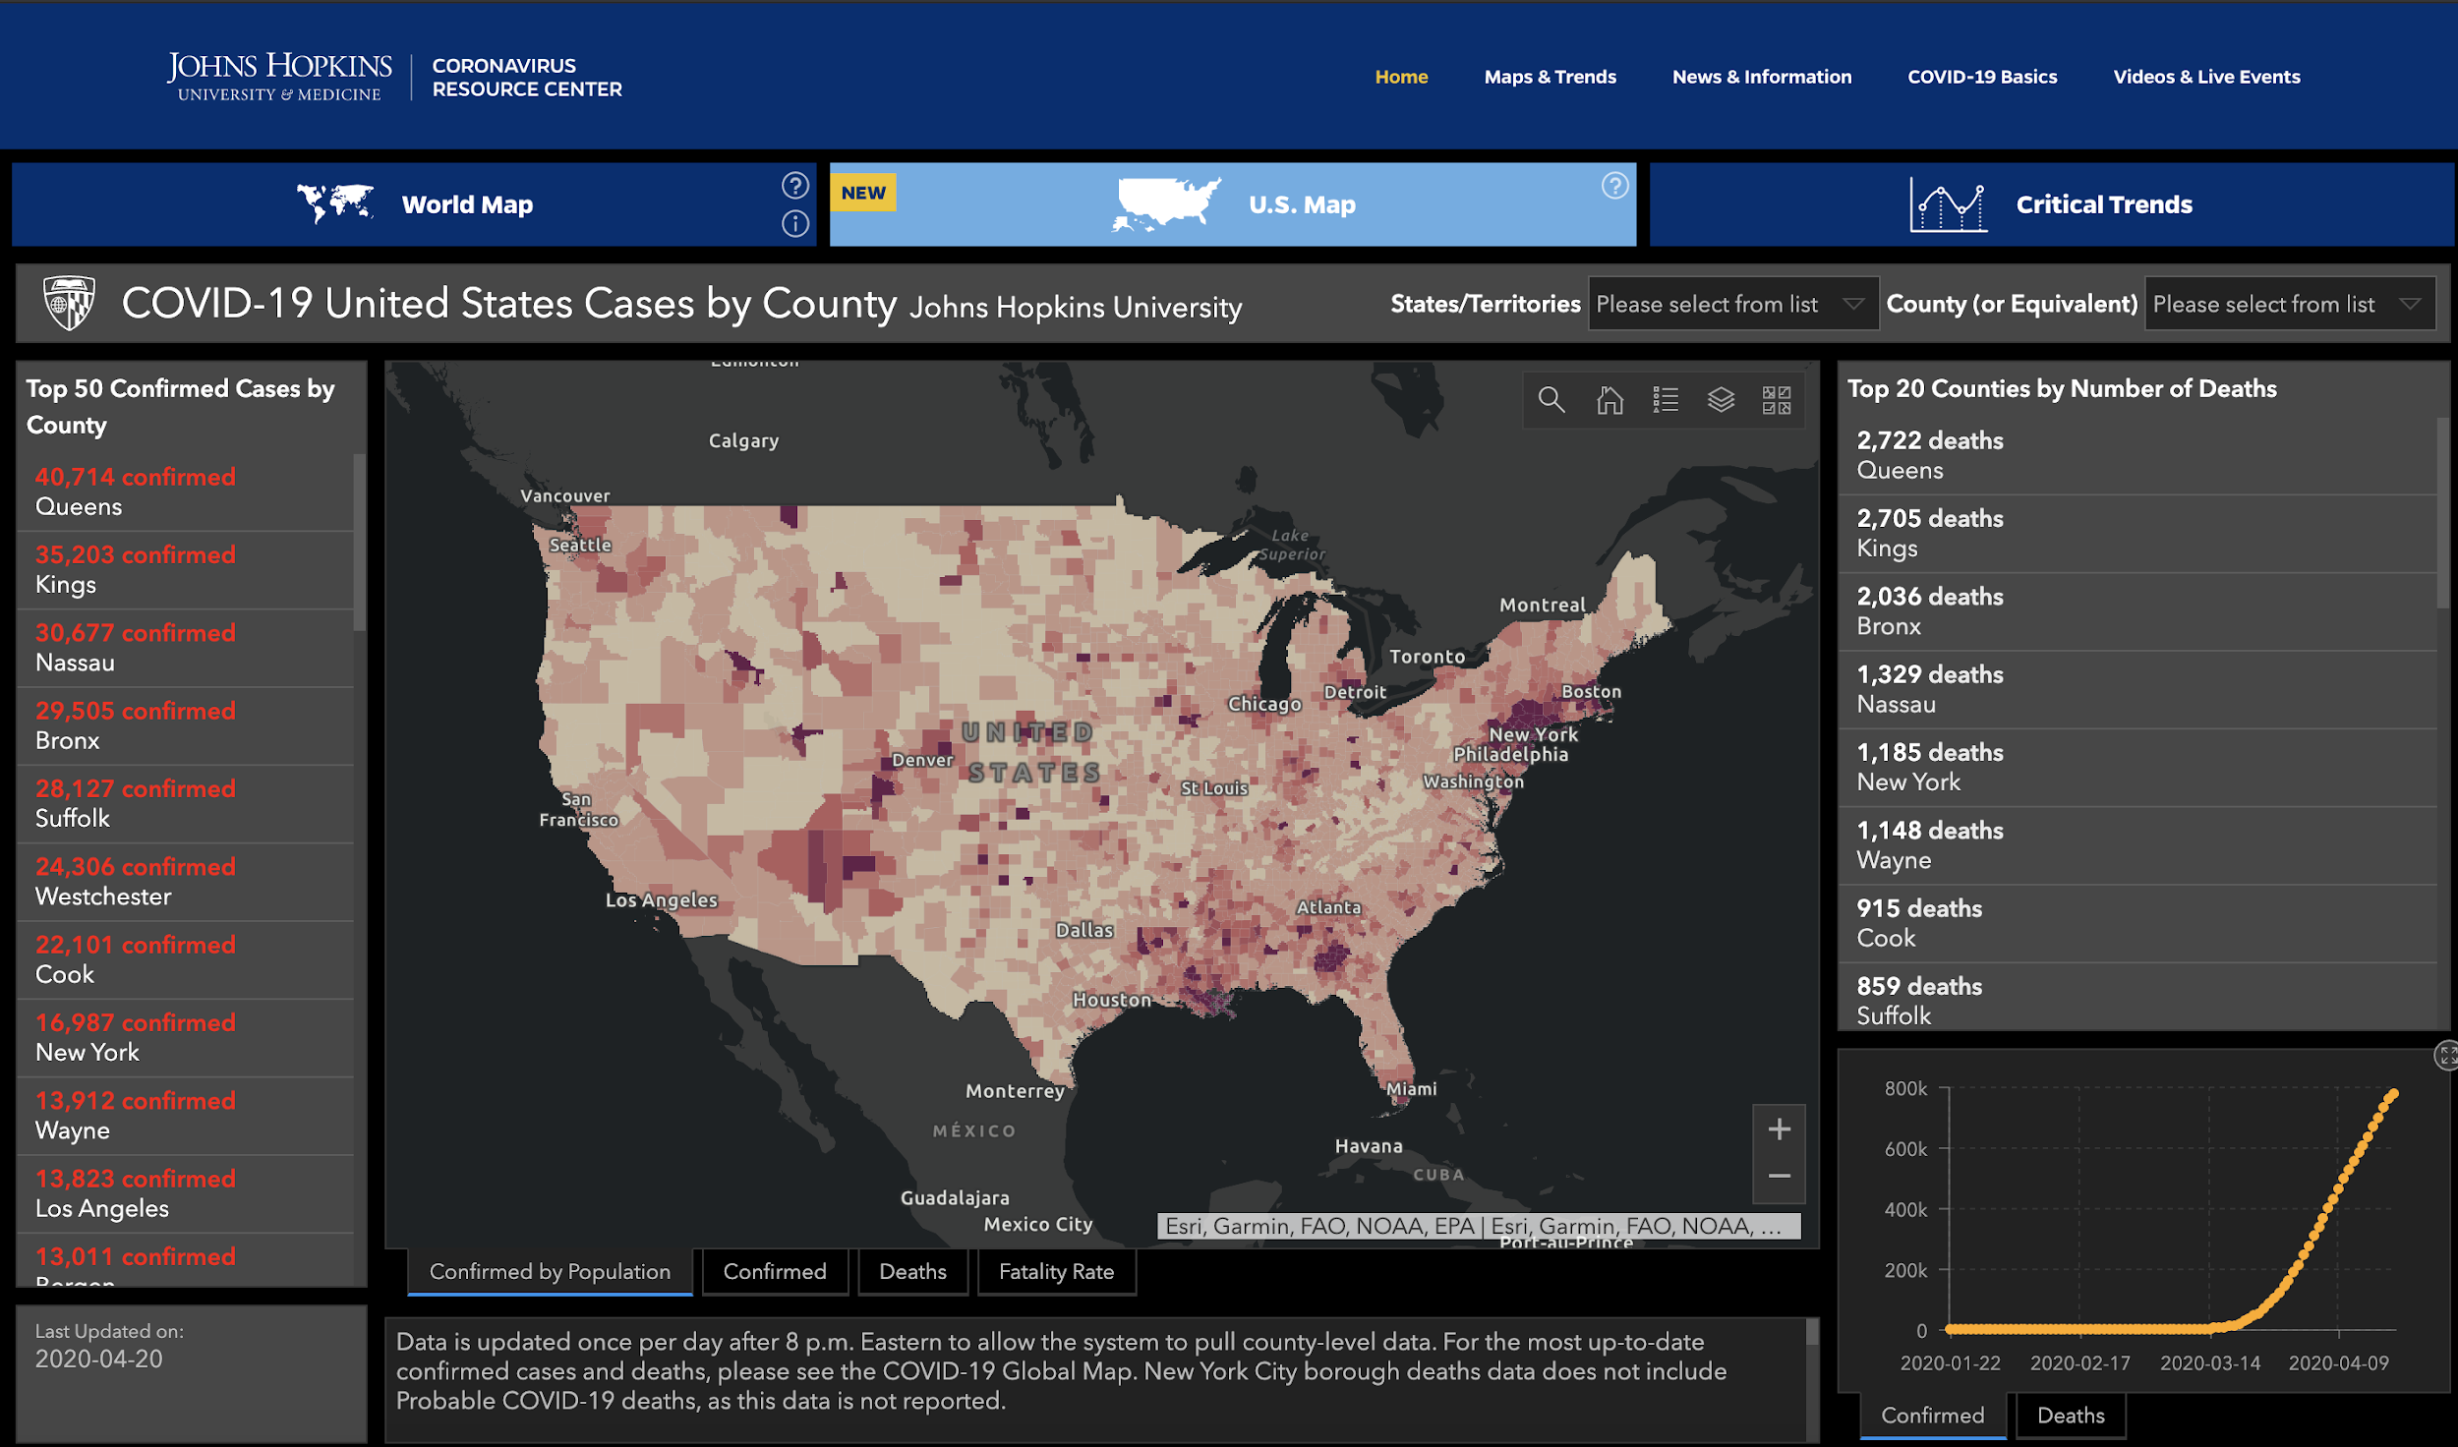
Sources
Inspiration : https://coronavirus.jhu.edu/us-map
Sources:
COVID-19 in USA:
https://github.com/datasets/covid-19/tree/master/data
POS Data for Liquid Hand Soap : IRI Data Total US MULO by State 12/1/19- YTD 3/22/20
State _ Loc File : State Coordinates off google

Slide 4
Thought Process...
Find COVID-19 confirmed cases and total deaths by day and by state
Retrieve liquid hand soap sales by state by week
Analyzing the data.
After searching for information we saw that Johns Hopkins University Center for System Science and Engineering (CSSE) had a repository with the latest COVID-19 confirmed cases and deaths by state and by day which we were able to retrieve for our project
Once we had COVID-19 data we wanted something interesting to compare the information with to help tell a story. While toilet paper would have been interesting, the next best information we could obtain was liquid soap sales from “IRI Data Total US MULO by State 12/1/19- YTD 3/22/20”
Once we built out the charts and analyzed the data we were able to see a natural progression of emergency declaration, to soap sale increases, and finally confirmed cases and deaths

Slide 5
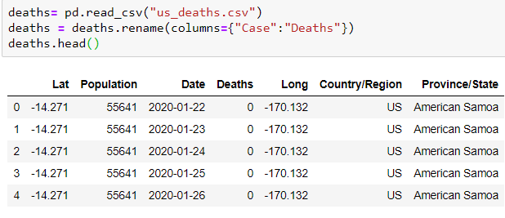
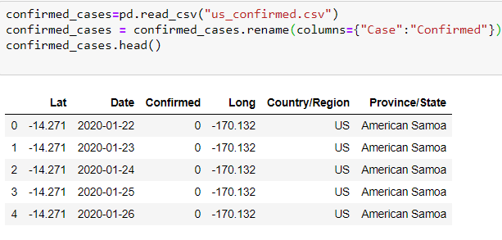
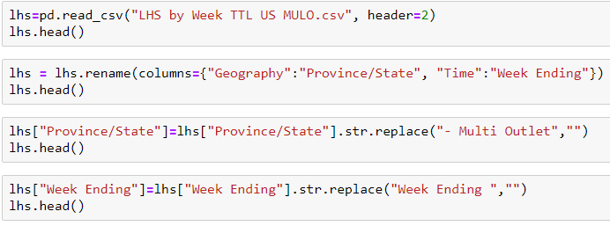
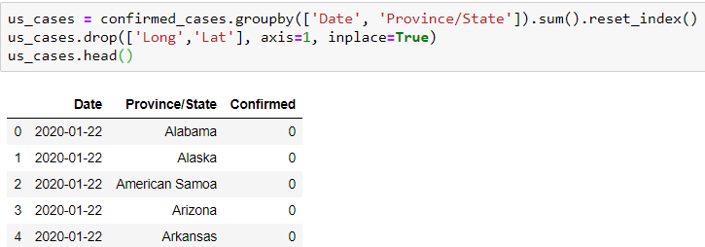
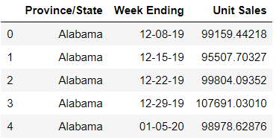
Clean up Process
Brought in the Data CSVs, dropped unnecessary data & renamed columns.
Grouped Covid-19 data sets by dates and states and then summed them for a total US view.

Slide 6
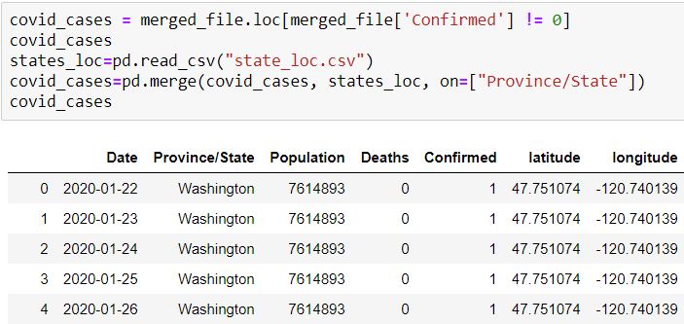
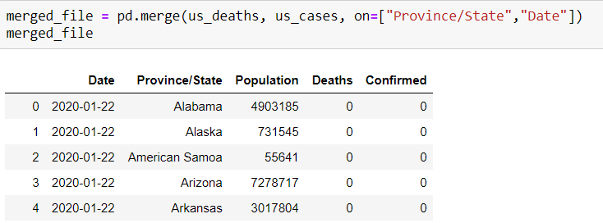
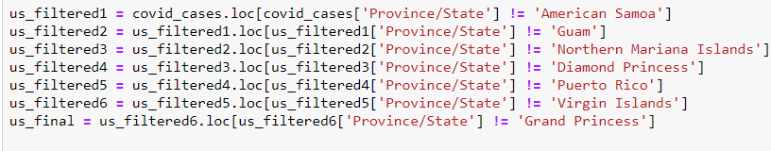
Clean up Process
Merged the 3 data sets and filtered the final DF

Slide 7
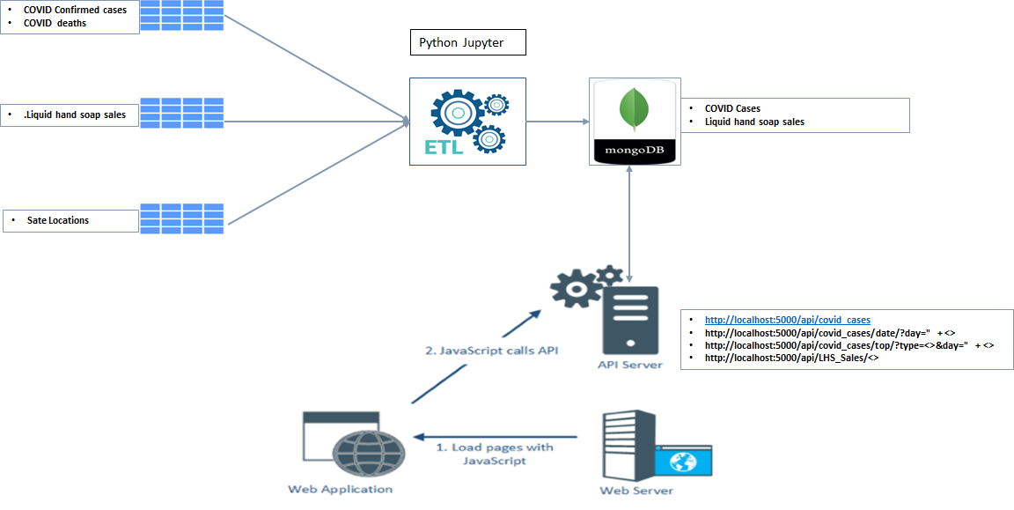
System flow...

Slide 8
Show & Tell Time

Slide 9
Top COVID-19 Dashboard Insights
25.5 MILLION
Jan 22nd
495.4Thousand
March 15th
7827
Deaths
Confirmed Cases in the USA as of 4/10/20
3.61% of people with COVID-19 have died in USA
In NY as of 4/10/20 , making it the state with the highest number of deaths to date ;
Week ending showing the rise of confirm cases and LHS sales
Units sold of Liquid Hand Soap in the USA the week of 3/15/20
First Confirmed Case in the US
WY has had 239 cases / 0 deaths
Highest % of deaths states are MI 5.7%, KY 5.3%, OK 4.9%
NC among the lowest death rates with 2.1%
3/13/20 TRUMP declares National Emergency
Highest week in LHS nationally
Texas had the highest sales of LHS on w/e 3/15 which sold 2.4M
2nd Highest sales that week was CA with 2.2M
Florida had 3rd place with 1.6M unit sold
As of 4/10 top 3 infected states and mortality states are the same ( NY, NJ, MI)
FL and TX in top 10 infected but not in top 10 mortality.
Proin vel tellus in felis
Molestie nec amet cum
First COVID-19 death reported on 2/29 in WA
NY first deaths on 3/14, 12 days after first confirmed case on (3/2/20)

